Slide 1


Riccardo BONAFEDE
Università di Padova
File Disclosure and Server-Side Request Forgery
https://cybersecnatlab.it

Slide 2

License & Disclaimer
License Information
Disclaimer
This presentation is licensed under the Creative Commons BY-NC License
To view a copy of the license, visit:
http://creativecommons.org/licenses/by-nc/3.0/legalcode
We disclaim any warranties or representations as to the accuracy or completeness of this material.
Materials are provided “as is” without warranty of any kind, either express or implied, including without limitation, warranties of merchantability, fitness for a particular purpose, and non-infringement.
Under no circumstances shall we be liable for any loss, damage, liability or expense incurred or suffered which is claimed to have resulted from use of this material.

Slide 3
Goal
Present common file disclosure vulnerabilities and their possible mitigations
Learn how to perform a Server-Side Request Forgery attack

Slide 4
Prerequisites
Lecture:
WS_1.1 - HTTP Protocol and Web Security Overview

Slide 5
Outline
File Disclosure
Impact and Overview
Paths 101
Path traversal attacks
Fixes
Server-Side Request Forgery

Slide 6
Outline
File Disclosure
Impact and Overview
Paths 101
Path traversal attacks
Fixes
Server-Side Request Forgery

Slide 7
File Disclosure
A file disclosure is the impact of certain vulnerabilities
As the name suggests, it consists of the ability to disclose/leak important files from a server
Because it is an impact, there are multiple classes of vulnerabilities that lead to file disclosure
For example, remote code execution is another type of vulnerability that could results in a file disclosure

Slide 8
File Disclosure
Files inside a server are critical information:
In many applications, users-uploaded files are the sensitive information that the application is protecting
The disclosure of such files can be a violation of the site policy

Slide 9
File Disclosure
It is also possible to steal configuration files from the webserver which might contain critical information items
Database configuration files often contain the credentials to access the database
Files like the tomcat-users.xml contain the credentials to access the tomcat manager
Files like flask configuration or web.config in a .net application contain the secret used to sign the session

Slide 10
File Disclosure
Finally, it is possible to steal the source code of the web application
For some business, the source code of the web application is its product/asset
An attacker in possession the source code is more effective
It is easier for the attacker to find other vulnerabilities, especially if the application was developed according to a security by obscurity model

Slide 11
File Disclosure
How can a web app disclose internal files?
Basically, everything that works with files can lead to a file disclosure vulnerability
There are standard sinks, and some of them are a trivial
If a user-controlled input manages to go inside these sinks, the web app is at risk

Slide 12
File Disclosure
Some sinks are trivial...
Every function in every programming language that manages files
Every flavor of open/fopen in every language
Flask send_file
…
As said before, it is also possible to leak files if the web app suffers from code execution

Slide 13
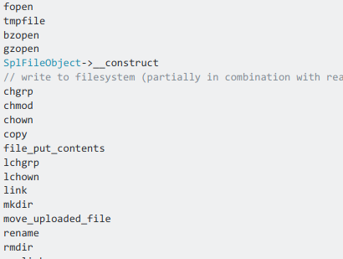
File Disclosure
Some sinks are trivial...
Every function in every programming language that manages files
Every flavor of open/fopen in every language
Flask send_file
…
As said before, it is also possible to leak files if the web app suffers from code execution

Slide 14
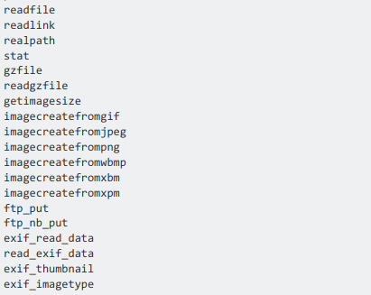
File Disclosure
Some sinks are trivial...
Every function in every programming language that manages files
Every flavor of open/fopen in every language
Flask send_file
…
As said before, it is also possible to leak files if the web app suffers from code execution

Slide 15
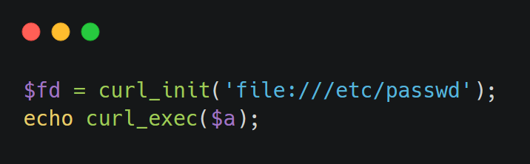
File Disclosure
Other sinks are less trivial
cURL is used as a http client. But it can also be used to open files

Slide 16
File Disclosure
It’s sometimes possible to leak important files just because they are publicly accessible
.git directory exposed
If you make your git directory open to the internet, everyone will be able to dump all files inside it
Web-server misrouting
It’s sometimes possible to trick a web server to return a .php file as an image...

Slide 17
Outline
File Disclosure
Impact and Overview
Paths 101
Path traversal attacks
Fixes
Server-Side Request Forgery

Slide 18
Paths 101
Let us focus on what happens if a user-controlled input finds a way to an open-like function
We first need to understand few things about how paths work

Slide 19
Paths 101
An absolute path is a path that describes the location of a file regardless of the working directory
/etc/passwd
A relative path is a path that describes the location of a file starting from the working directory
foo/bar

Slide 20
Paths 101
Paths are composed by a dirname and a basename
The dirname is the portion of the path up to the last /
The basename is the portion of the path after the last /
/usr/bin/firefox
Dirname
Basename

Slide 21
Paths 101
Every directory has two special subdirectories:
The current directory, whose name is .
And the parent directory, whose name is ..
The parent directory is useful for file disclosure because it permits to access deeper directories inside the file system
/foobar/./ /foobar/
/foobar/../baz /baz

Slide 22
Paths 101
A path in its shortest form is called normalized
For example:
/foo/bar is normalized, there is no way to make it shorter
//foo/bar is not normalized, /foo/bar is shorter
/foo/./bar is not normalized, /foo/bar is shorter
What about /foo/test/../bar?

Slide 23
Paths 101
What about /foo/test/../bar?
Its shortest form would be /foo/bar, but what happens if /foo/test/ does not exist?
If the path is normalized before opened, then everything is fine: we can access /foo/bar without any problem
If the path is not normalized, then the open would fail because /foo/test/ does not exist, and so ..

Slide 24
Outline
File Disclosure
Impact and Overview
Paths 101
Path traversal attacks
Fixes
Server-Side Request Forgery

Slide 25
Path Traversal
Path traversal is a vulnerability that leads to a file disclosure
It happens when a user-controlled input finds its way into an open() or an equivalent function
If there are no security checks or security sanitizations, an attacker could inject paths that are not meant to be opened

Slide 26
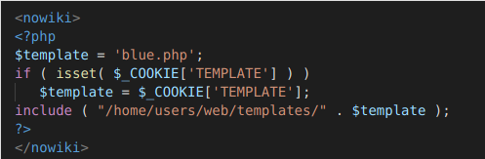
Path Traversal
Path traversal is a vulnerability that leads to a file disclosure
It happens when some user-controlled input finds its way into an open() or an equivalent function
If there are no security checks or security sanitizations, an attacker could inject paths that are not meant to be opened

Slide 27
Path Traversal
Path traversal is a vulnerability that leads to a file disclosure
It happens when some user-controlled input finds its way into an open() or an equivalent function
If there are no security checks or security sanitizations, an attacker could inject paths that are not meant to be opened
Entry point

Slide 28
Path Traversal
Path traversal is a vulnerability that leads to a file disclosure
It happens when some user-controlled input finds its way into an open() or an equivalent function
If there are no security checks or security sanitizations, an attacker could inject paths that are not meant to be opened
Sink

Slide 29
Path Traversal
Few cases might happen:
Plain injection open($input)
Prepended injection open($input + '/foobar')
Appended injection open('/foobar' + $input)
Appended and prepended open('/foo'+$input+'/bar)

Slide 30
Full Plain Path Traversal
open($input)
Without security checks, it is possible to leak every file on the filesystem
Other problems:
Protocols like HTTP / gopher / ssh could be used, making it a Server-Side Request Forgery
For some functions, it is possible to execute arbitrary code. (For example if the injection is inside Perl's open¹)
1: https://perldoc.perl.org/functions/open

Slide 31
Full Plain Path Traversal
The exploit for this kind of injection is trivial
Just put the path of the file to disclose
A useful test file on Unix systems is /etc/passwd
Why?
It always exists and is accessible by every user of the system
Is a good target to properly check if there is an actual injection inside an open-like function

Slide 32
Appended Path Traversal
open('/somedir/' . $input)
It is the most common one
It is a plain injection without the possibility to use other protocols
If there is no protection, it is possible to leak every file in the filesystem

Slide 33
Appended Path Traversal
To exploit this, append some ../ in order to get to the root directory
In this way, it is possible to access every file of the filesystem
For example, try to inject:
../../../../../etc/passwd

Slide 34
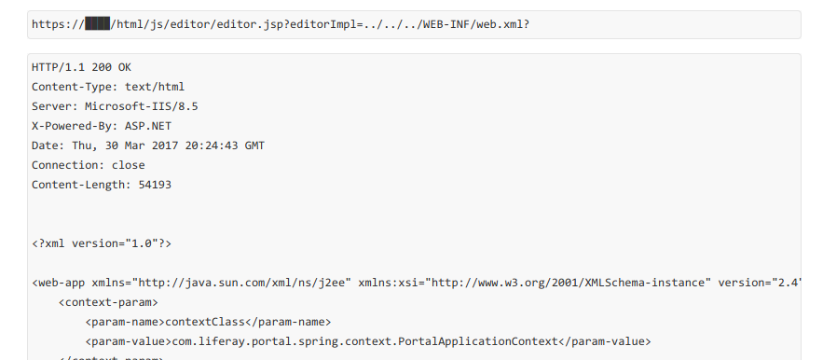
Appended Path Traversal
To exploit this you can append some ../, in order to get to the root directory.
In this way you can access every file of the filesystem

Slide 35
Appended Path Traversal
To exploit this you can append some ../, in order to get to the root directory.
In this way you can access every file of the filesystem

Slide 36
Prepended Path Traversal
open($input . 'someotherdata')
A little bit trickier than the previous one, normally in two forms:
With an appended extension
file_get_content($input . '.txt')
Or with an appended filename/directory
file_get_contents($input . '/somefile.txt')

Slide 37
Prepended Path Traversal
Allows the disclosure of files whose path finish with a hardcoded suffix
There are some tricks

Slide 38
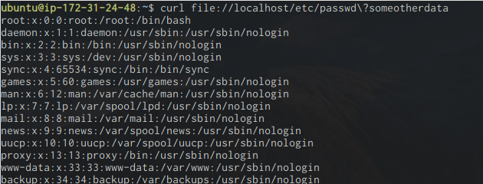
Prepended Path Traversal
Some languages support the file:// scheme.
Particularly interesting because it is parsed as a URL
file://localhost/path/to/file?someotherdata == /path/to/file

Slide 39
Prepended Path Traversal
Some scripting languages internally use the C function open
Because of how C handles strings, open will ignore everything after a NULL character (\x00)
This trick worked very well for older versions of PHP, but now is patched
http://foo.bar/?file=../../etc/passwd%00

Slide 40
Path Traversal
A blacklist is a common mitigation against these types of vulnerabilities
A blacklist is used to look for "dangerous" words inside a user-supplied input
If a dangerous word is found, the system rejects the input or sanitizes it, thus removing the dangerous word

Slide 41
Path Traversal
Blacklists are insecure, because they are error prone
You will never be able to insert all the edge cases!
For example, does a blacklist that contains the word 'proc' prevent access to the '/proc/' directory?
No, /dev/fd/ is a link to /proc/self/fd, so you can access every file of /proc/ with the directory /def/fd/../../

Slide 42
Path Traversal
What if we blacklist single dangerous characters like “.” or “/” ?
The problem here is congruency. Some languages, javascript in particular, don't handle malformed unicode characters.
For example, the unicode character \u012e ( Į ), when converted to ascii, is incorrectly transformed to the byte \x2e ( . )
You can see that if the blacklist is using unicode but the open function is using the ASCII encoding then there is a problem

Slide 43
Outline
File Disclosure
Impact and Overview
Paths 101
Path traversal attacks
Fixes
Server-Side Request Forgery

Slide 44
Fixes
Normalize paths
In this way there are no "nasty points" inside paths, and it is possible to enforce a dirname
Pay attention that the function used for normalization parses paths the same way of the open function
In this way, you will be able to avoid problems caused by incongruences

Slide 45
Fixes
Another good mitigation is a chroot
Chroots are "jails" enforced by the OS or by some programming languages
If a path is set as a chroot, then every access outside this path would be denied by the OS/interpreter
If an attacker manages to bypass all security checks, he/she will be stopped by the chroot

Slide 46
Fixes
In summary
Blacklists are insecure, as they can be bypassed in different ways
Whitelists work better, but defeat the purpose of passing user input inside an open function
Avoid incongruency, check paths in the same way you open them

Slide 47
Outline
File Disclosure
Impact and Overview
Paths 101
Path traversal attacks
Fixes
Server-Side Request Forgery

Slide 48
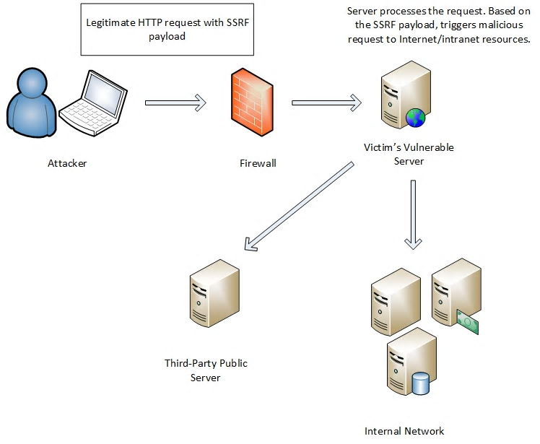
Server-Side Request Forgery
A Server-Side Request Forgery is a vulnerability that allows an attacker to send a network request from the remote application

Slide 49
Server-Side Request Forgery
The impact varies a lot, depending on the control the attacker has on the forged request:
Control over the whole TCP packet
Control over some parts of an HTTP request
Control only over the host/port to which the request is made
…

Slide 50
Server-Side Request Forgery
SSRFs are dangerous because they allow bypassing the firewall
If the internal network is not properly designed, it is possible to access to sensible hosts, like internal web applications and control panels

Slide 51
Server-Side Request Forgery
If the vulnerable web application is hosted on a cloud instance, things become more interesting
Some instances have access to specials URLs that often contain critical data

Slide 52
Server-Side Request Forgery
For example, AWS instances can access the metadata API, at the URL http://169.254.169.254/
This host contains sensible information such as the IAM security credentials and general information about the vulnerable instance¹
1: https://blog.appsecco.com/an-ssrf-privileged-aws-keys-and-the-capital-one-breach-4c3c2cded3af

Slide 53
Server-Side Request Forgery
If there is no output, the SSRF is called blind SSRF
It is less dangerous than a normal SSRFs
With a blind SSRF it is possible to
Map the internal network
Trigger actions on hosts behind the firewall¹
1: A nice collection of payloads to use: https://blog.assetnote.io/2021/01/13/blind-ssrf-chains/

Slide 54
Server-Side Request Forgery
It is possible to map the internal network by trying URLs/ports, and by looking at the response time
This can be done if the response time of the vulnerable endpoint depends on the response time of the SSRF request

Slide 55
Server-Side Request Forgery
To find an SSRf, you should:
Find suspicious endpoints: If you see a URL inside a parameter try to put a URL controlled by you. You can use a tool like ngrok
If you have a pingback at your host, then probably you have an SSRF. Then you should try to insert internal hostnames, like "localhost" or common internal IPs (192.168.1.1,10.0.0.1, and so on..)
Examine the response time!

Slide 56
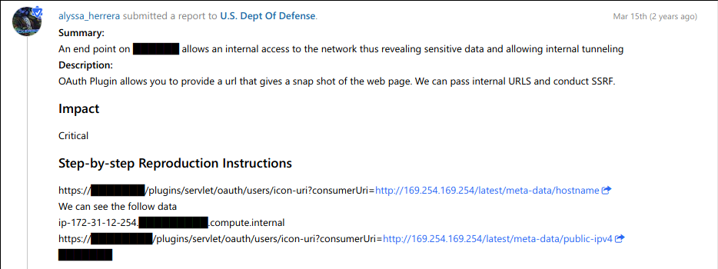
Server-Side Request Forgery
To find an SSRf, you should:
Find suspicios endpoints. If you see a url inside a paramater try to put a URL controlled by you. You can use a tool like ngrok
If you have a pingback at your host, then probabilly you have an SSRF. Things you should try now is to insert internal hosts, like "localhost" or common internal IPs (192.168.1.1,10.0.0.1, and so on..)
Look at the response time!

Slide 57
Server-Side Request Forgery
To find an SSRf, you should:
Find suspicios endpoints. If you see a url inside a paramater try to put a URL controlled by you. You can use a tool like ngrok
If you have a pingback at your host, then probabilly you have an SSRF. Things you should try now is to insert internal hosts, like "localhost" or common internal IPs (192.168.1.1,10.0.0.1, and so on..)
Look at the response time!

Slide 58
Server-Side Request Forgery
Every piece of code that can issue a connection can lead to this vulnerability
Common functions/libraries are:
PHP open-like functions
CURL
Python's urllib
...

Slide 59
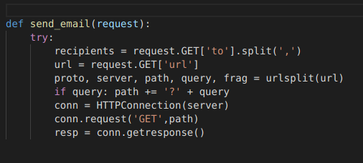
Server-Side Request Forgery

Slide 60
Server-Side Request Forgery
Snipped of code from Graphite

Slide 61
Server-Side Request Forgery
Generally speaking, SSRFs are really difficult to avoid
The most effective way is to check the user-supplied host against a whitelist
Another good mitigation is to make requests from a host that is isolated from sensitive internal hosts

Slide 62
Riccardo BONAFEDE
Università di Padova
File Disclosure and Server-Side Request Forgery
https://cybersecnatlab.it

